Slide 1
Nutrition Educator Training
Supporting Effective Nutrition Educators
^{and Healthy Communities}

Slide 2
PRETEST

Slide 3
Training Objectives
By the end of this training, you will be able to:
1
Utilize key information from the Nutrition Educator Guide to prepare and deliver effective nutrition education.
2
Complete at least one handout before delivering an effective nutrition education lesson.
3
Write the purpose of nutrition education.
4
5
6
Identify three things to know about one’s audience before planning a lesson.
List two strategies for engaging participants with diverse classroom behavior and learning styles.
Write one reason why it is helpful to set behavior change goals with participants.

Slide 4
Icebreaker
Name
Organization
Favorite Childhood Food

Slide 5
NUTRITION EDUCATOR GUIDE

Slide 6
HANDOUTS
Effective
Nutrition
Education
Understand Evaluation
Engage
Your
Audience
Lesson
Planning
Checklist
Plan Your
Lesson

Slide 7
THE FOUR P’S
Purpose
Plan Your Lesson
Prepare
Yourself
Put It Into Action

Slide 8
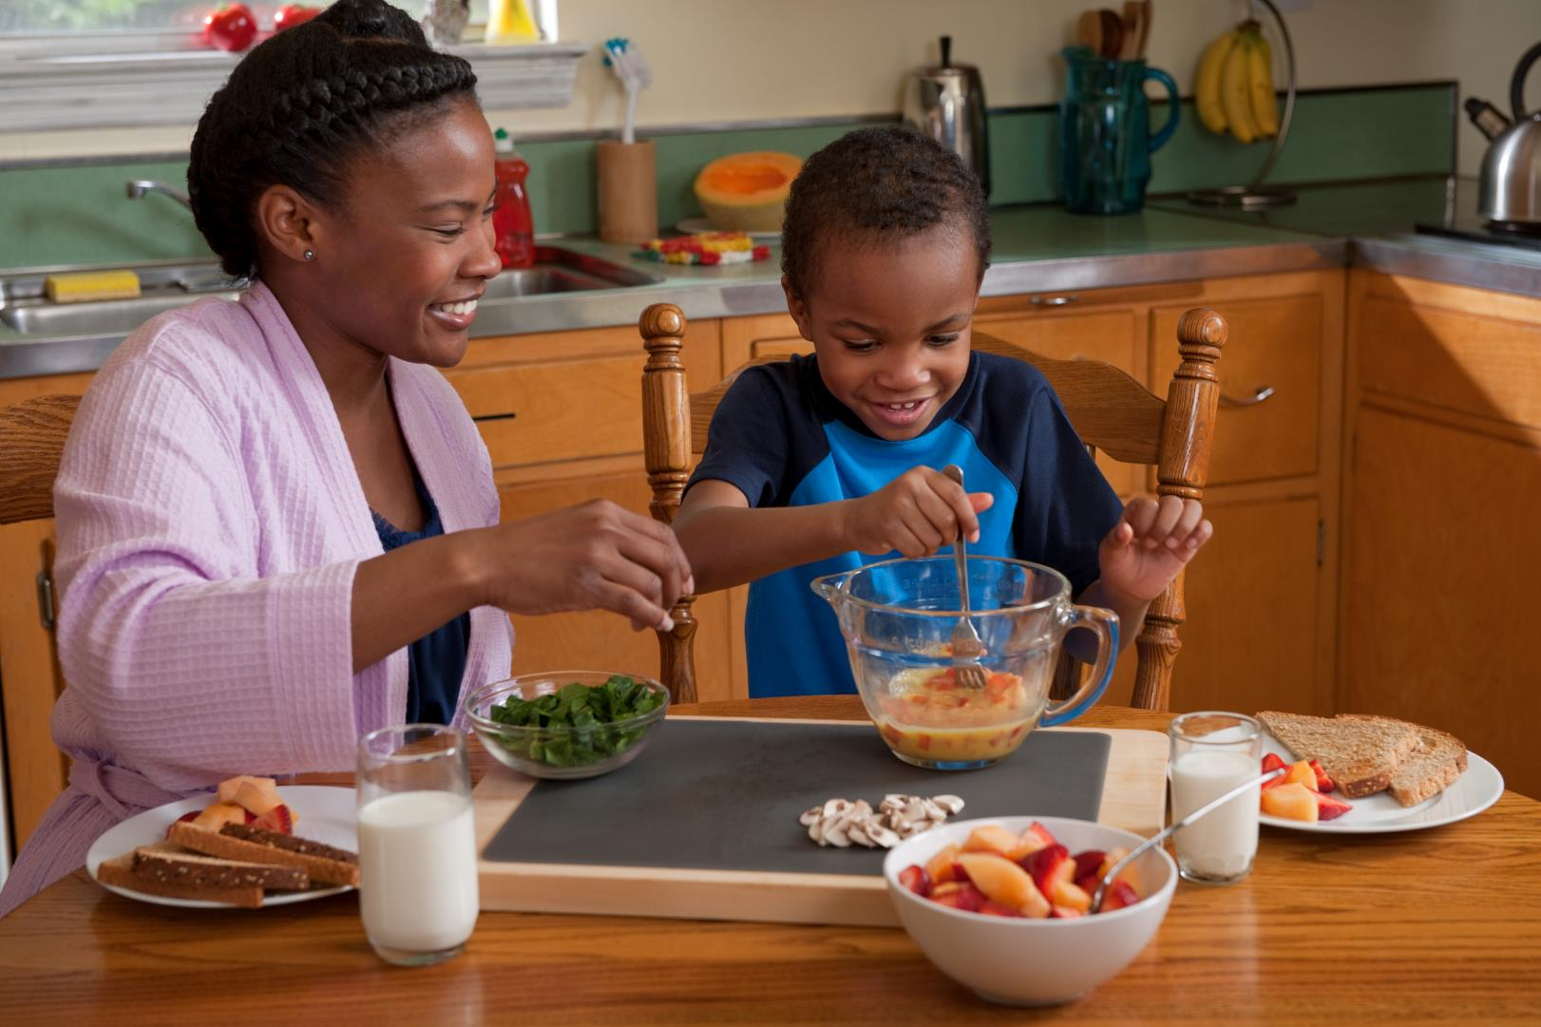
PURPOSE
OF NUTRITION EDUCATION
The purpose of nutrition education is to empower participants to make educated decisions about the food they select everyday at every eating occasion.

Slide 9
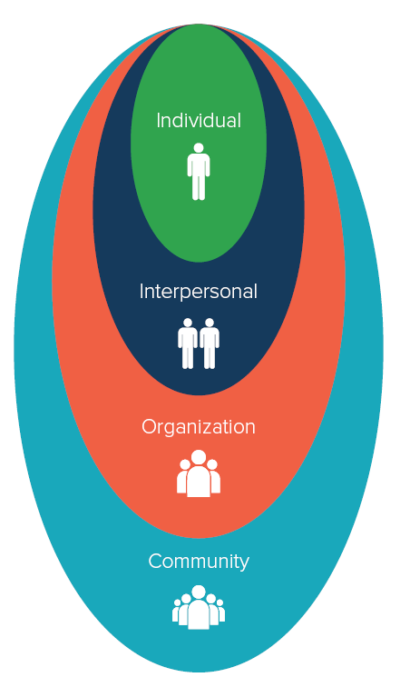
Social Ecological Model
Individual
Interpersonal
Organization
Community

Slide 10
Why do you want to be a nutrition educator?

Slide 11
EFFECTIVE NUTRITION EDUCATION
Healthy behavior change is the goal
Focus lessons on specific topics
Involve participants and the community when possible
Focus on participants’ motivation to change
Help students set goals to improve self-efficacy

Slide 12
1
What is the purpose of nutrition education?
2
Why does the Social Ecological Model matter for nutrition education?
REVIEW:
PURPOSE
3
What are the key elements of effective nutrition education?
4
Where can you find the Nutrition Educator Guide and handouts?

Slide 13
PLAN YOUR LESSON

Slide 14
Know Your Audience
Size of audience and age range
Primary language
Education and literacy level
Culture and ethnicity
Health literacy and misconceptions
Food resources and environment

Slide 15
KNOW YOUR AUDIENCE
Language Case Study
Which steps should the educator have taken when preparing for his lesson?
Ask the language of the group prior to arrival
Use translated materials
Decide translating the material was too much effort
Cancel the class

Slide 16
KNOW YOUR AUDIENCE
Language Case Study
Which steps should the educator have taken when preparing for his lesson?
Ask the language of the group prior to arrival
Use translated materials
Decide translating the material was too much effort
Cancel the class

Slide 17
KNOW YOUR AUDIENCE
Culture Case Study
What considerations might you make? What should you do to prepare for the class?
Do your research. Speak with the coordinator or people in the community to find ethnic recipes with a healthy twist.
Ask for an interpreter to be present to help translate your presentation so all participants can understand what you say.
Reflect on your own food culture and use your experience to relate to your participants.
All of the above

Slide 18
KNOW YOUR AUDIENCE
Culture Case Study
What considerations might you make? What should you do to prepare for the class?
Do your research. Speak with the coordinator or people in the community to find ethnic recipes with a healthy twist.
Ask for an interpreter to be present to help translate your presentation so all participants can understand what you say.
Reflect on your own food culture and use your experience to relate to your participants.
All of the above

Slide 19
KNOW YOUR AUDIENCE
Literacy Case Study
Which of these are literacy factors that you should take into consideration?
Reading Levels
Time of Day
Age
Education Level

Slide 20
KNOW YOUR AUDIENCE
Literacy Case Study
Which of these are literacy factors that you should take into consideration?
Reading Levels
Time of Day
Age
Education Level

Slide 21
SET OR REVIEW GOALS AND OBJECTIVES
GOALS
S
M
A
R
T
Specific
Measurable
OBJECTIVES
Achievable
Relevant
Time-bound

Slide 22
TIME TO PRACTICE
Participants will learn about fruits and vegetables.
Participants will change their mind about junk food.
Participants will eat healthier.

Slide 23
CHOOSE YOUR TEACHING METHODS
INTERACTIVE
ACTIVITIES
ROLE PLAYING
FOOD
DEMONSTRATIONS
DISCUSSIONS

Slide 24
YOUR FOOD DEMONSTRATION
Explain what you are doing.
Discuss substitutions.
Relate demo to lesson topic.
Choose affordable ingredients.
Pick age and culturally appropriate recipes.
Allow adequate time for demo.

Slide 25
FOOD SAFETY

Slide 26
FOOD ALLERGIES
DAIRY
WHEAT
EGG
SOY
PEANUT
TREENUT
FISH
SHELLFISH

Slide 27
PLAN OR REVIEW YOUR EVALUATION
OUTCOME EVALUATION
How well does the lesson change the audience’s:
Knowledge
Commitment to change their behavior
PROCESS EVALUATION
Was the lesson conducted as planned?
Did audience represent target audience?
Was program delivered as intended?
Was educator prepared and engaged?

Slide 28
1
What should you know about your audience?
2
What is a goal?
What is an objective?
REVIEW:
PLAN YOUR LESSON
3
Where can you find more information about food safety and allergies?
4
Why are evaluations important?
How do I conduct an evaluation?

Slide 29
BREAK

Slide 30
PREPARE YOURSELF

Slide 31
COMMUNICATION
Use nonjudgmental words and body language.
Share about yourself.
Learn about participants.
Smile and make eye contact.
Establish classroom expectations.
Be enthusiastic.

Slide 32
COMMUNICATION
Communication Case Study
What could Trey have done better to engage the audience?
Introduce himself and share his qualifications and some personal information
Display enthusiasm and excitement by telling the audience he is glad to be there
Have positive body language by unfolding his arms, smiling, and making eye contact
All of the above

Slide 33
COMMUNICATION
Communication Case Study
What could Trey have done better to engage the audience?
Introduce himself and share his qualifications and some personal information
Display enthusiasm and excitement by telling the audience he is glad to be there
Have positive body language by unfolding his arms, smiling, and making eye contact
All of the above

Slide 34
MANAGING YOUR AUDIENCE
Establishing Expectations
Review classroom guidelines
Enforce guidelines as necessary
Redirect discussions as needed
Instruct participants to raise their hand to speak
If working with kids, ask the teacher which methods work for the class

Slide 35
MANAGING YOUR AUDIENCE
Managing Your Audience Case Study
Did the educator successfully manage the audience?
Yes
No

Slide 36
MANAGING YOUR AUDIENCE
Managing Your Audience Case Study
Did the educator successfully manage the audience?
Yes
No

Slide 37
MANAGING YOUR AUDIENCE
DOMINATORS
DISRUPTORS
COMPLAINERS
KNOW-IT-ALLS
DIGRESSERS
RESISTORS
JOKESTERS
LATECOMERS

Slide 38
1
What are some ways to engage your audience through your communications?
2
What are the different personalities you are likely to encounter in the classroom?
REVIEW:
PREPARE YOURSELF
3
What are some strategies for dealing with disruptive participants?

Slide 39
GROUP ACTIVITY

Slide 40
PUT IT INTO ACTION

Slide 41
PARTICIPANT GOAL SETTING
What behavior will I change?
By when can I make the change?
How will I know I reached my goal?
What actions must I take to change?
Why is this behavior change important to me? What challenges might I face?
What will I do to overcome those challenges?
What can help me make these changes?
How will I keep myself motivated?
How will I hold myself accountable?

Slide 42
AFTER THE LESSON
Strategies to reinforce learning at home
Providing additional resources and social media links
Share evaluation data with program administrator

Slide 43
1
What should you consider when setting goals with participants?
REVIEW:
PUT IT INTO ACTION
2
What actions must be taken after your nutrition lesson?

Slide 44
Training Objectives
Review
1
How can you use information in the Nutrition Educator Guide to prepare and deliver effective nutrition education?
2
Which handouts would you complete before delivering an effective nutrition education lesson?
3
What is the purpose of nutrition education?
4
5
6
Why is it helpful to set behavior change goals with participants?
What are three things you need to know about your audience before planning a lesson?
What are two strategies for engaging participants with diverse classroom behavior and learning styles?

Slide 45
POSTTEST

Slide 46
Thank
You

